Slide 1

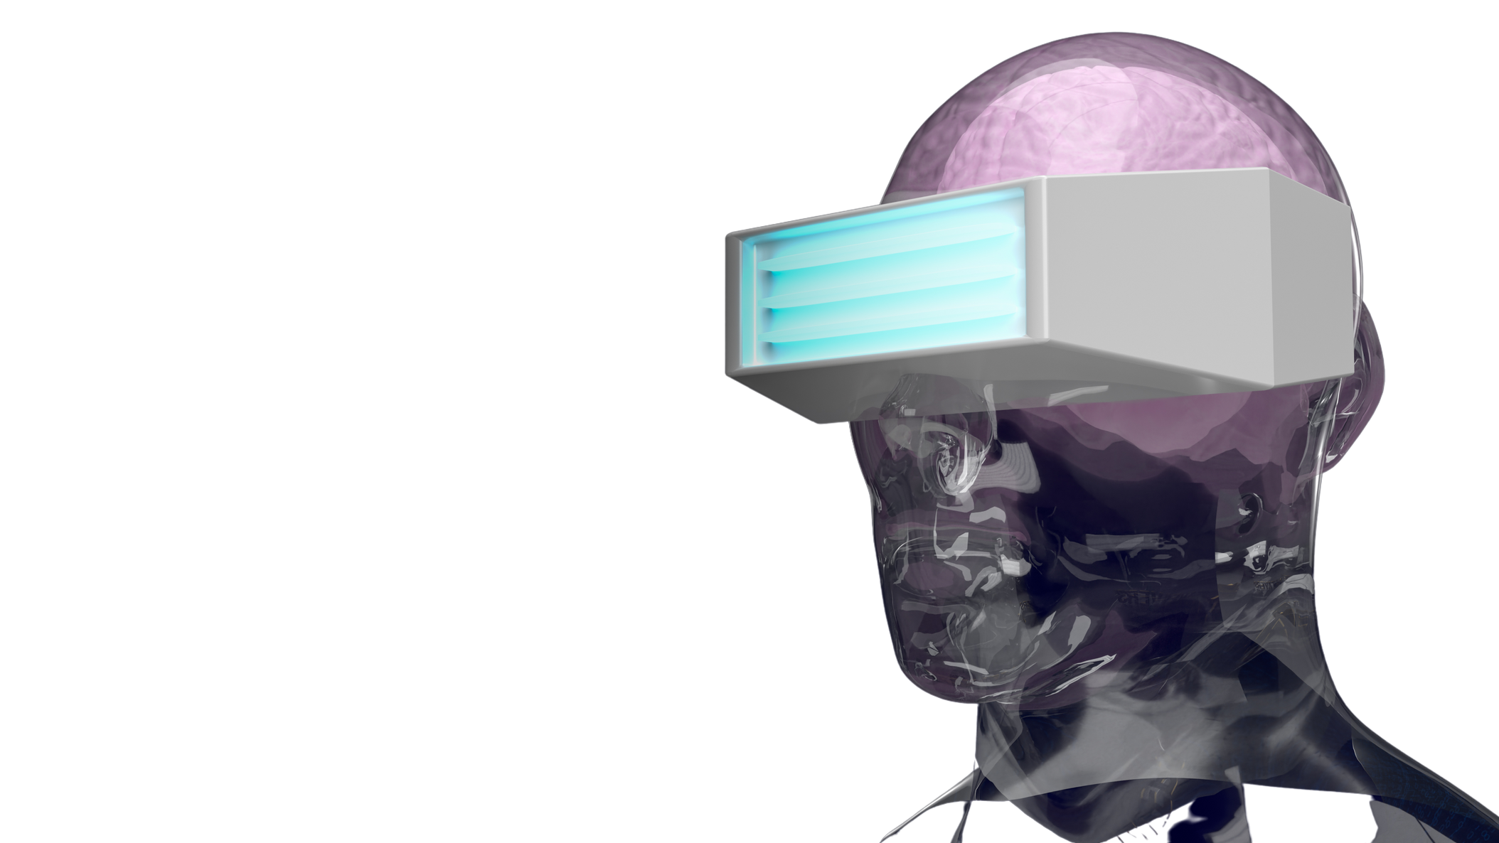

Metaverse
Quiz
How much do you know about the metaverse?

Slide 2





Which statement best describes the metaverse?
A virtual world that connects people worldwide without the internet.
A non-physical world designed for people involved in VR gaming activities.
A.
B.
A virtual world designed to support the latest 5G mobile technology.
A non-physical world in which people interact virtually through technology.
C.
D.

Slide 3





How are Augmented Reality, Virtual Reality, and the metaverse related?
Metaverse combines virtual reality, augmented reality, and the internet.
Virtual realities are limited in size where as the Metaverse provides access to all internet.
A.
B.
Users can control their presence in the real world in AR, VR, & the metaverse.
No devices (like headset or glasses) are needed to access these virtual worlds.
C.
D.

Slide 4



Where did the name 'metaverse' come from?
A.
Bill Gates
B.
Google
Neil Stephenson
Mark Zuckerburg
C.
D.

Slide 5


Which of the following companies is NOT in the race for building a metaverse?
A.
Google
B.
Microsoft
C.
Amazon
A.
Facebook

Slide 6
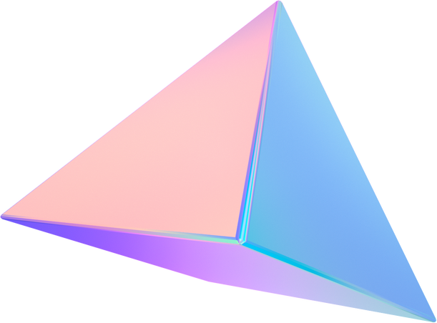


Can you access the Metaverse today?

Slide 7



What will the metaverse look like?
A
B
C
Companies create their own versions (resulting in many versions)
Different versions of the metaverse will integrate into one
Companies all build a metaverse together
D
E
Hopefully pretty cool
All of the above

Slide 8
What has been a very popular game leading us to thie 3d virtual relatiy world?
A.
Pokemon Go
B.
Unreal
C.
Geocaching
D.
Ingress

Slide 9
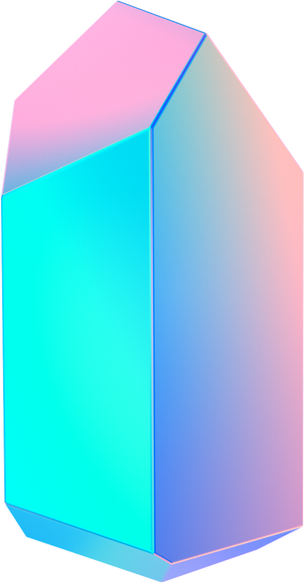

What is Facebook's approximate cost to make the metaverse?
A.
10 million USD
B.
50 million USD
C.
10 billion USD
A.
20 billion USD

Slide 10


What are some things you could see or do in the metaverse?
A
B
C
Advertise your company
Explore a new city
Go to space in real life
D
E
Buy and sell physical goods
Attend a work meeting

